Slide 1

CSC349 User Experience
Statistical Tests: Designing A/B and Quantitative Analysis
Notes:
Welcome to CS-130
Should be fun!
The “just don’t get caught module”
Teach how to program, teach you how to design stuff, teach you how to work in teams, what’s the point of this module?

Slide 2

Lecture Overview
We have frequently mentioned A/B testing in this lecture series but we really should more formally define it
We’ll discuss what it is, different measures of it and some famous examples
We’ll also compare it to classical stats tests
Finally, we’ll talk about a common trap in stats and A/B testing: data dredging
Notes:
We don’t know is the short answer to point one
Not just career but life!
Dr.s and Lawyers
Argument about professional obligations
This is going on around you as we speak!
ITS ALSO ABOUT SKILLS DEVELOMMENT – RESEARCH AND CRITICAL APPRAISAL
TRANSITION: What’s going on in this lecture?

Slide 3
A/B testing
In UX design and research A/B testing refers to the practice of splitting user of a live product into two groups (A and B) and exposing them to differing design choices
This is a common technique that allows us to gather strong evidence for our design choices
Core question to decide: do I need to do stats?
Key to answering this question is knowing if you are working with a population or with a sample?
Notes:
We don’t know is the short answer to point one
Not just career but life!
Dr.s and Lawyers
Argument about professional obligations
This is going on around you as we speak!
ITS ALSO ABOUT SKILLS DEVELOMMENT – RESEARCH AND CRITICAL APPRAISAL
TRANSITION: What’s going on in this lecture?

Slide 4
Some A/B metrics
Am I retaining my website users?
Measure the time on the site
Is this making my product faster to use
Measure time to complete tasks
Do my users make less mistakes
Number of times that a user has to undo
Can my users find features the first time they need them
Count the times they use help or back button
Do my users learn to use the interface
Repeat users better at tasks than new users
Notes:
We don’t know is the short answer to point one
Not just career but life!
Dr.s and Lawyers
Argument about professional obligations
This is going on around you as we speak!
ITS ALSO ABOUT SKILLS DEVELOMMENT – RESEARCH AND CRITICAL APPRAISAL
TRANSITION: What’s going on in this lecture?

Slide 5
Some A/B metrics
Am I retaining my website users?
Measure the time on the site (satisfaction)
Is this making my product faster to use
Measure time to complete tasks (efficiency)
Do my users make less mistakes
Number of times that a user has to undo (error recovery)
Can my users find features the first time they need them
Count the times they use help or back button (learnability)
Do my users learn to use the interface
Repeat users better at tasks than new users (memorability)
Notes:
We don’t know is the short answer to point one
Not just career but life!
Dr.s and Lawyers
Argument about professional obligations
This is going on around you as we speak!
ITS ALSO ABOUT SKILLS DEVELOMMENT – RESEARCH AND CRITICAL APPRAISAL
TRANSITION: What’s going on in this lecture?

Slide 6
Measuring metrics
How do you divide users and how do you collect information?
Division
Technical questions (app store change, website redirection, etc.)
Study validity questions (random sampling method, representative samples needed?)
Collecting information
Software logging
Questionnaires
Notes:
We don’t know is the short answer to point one
Not just career but life!
Dr.s and Lawyers
Argument about professional obligations
This is going on around you as we speak!
ITS ALSO ABOUT SKILLS DEVELOMMENT – RESEARCH AND CRITICAL APPRAISAL
TRANSITION: What’s going on in this lecture?

Slide 7
Real world A/B testing examples (both UX and not)
Dating websites
Determining the price someone will pay for a service or how often people meet up
Online retailers
Purchases per 100,000 visits
Complex software systems
Adobe looking at the variety of features people use before and after a new set of tooltips were added
Social media
Facebook’s deliberate mood altering studies used A/B testing
These raise questions about how ethical you think this practice is, the process is (probably) legal but…..
Notes:
We don’t know is the short answer to point one
Not just career but life!
Dr.s and Lawyers
Argument about professional obligations
This is going on around you as we speak!
ITS ALSO ABOUT SKILLS DEVELOMMENT – RESEARCH AND CRITICAL APPRAISAL
TRANSITION: What’s going on in this lecture?

Slide 8
Descriptive statistics
Imagine that we have gathered together a large volume (100s of samples) of data on a given topic
Maybe we measured the number of times that people made a mistake with our interface
Maybe we measured the time it took people to complete a simple task using our system
How might we present these results to people in a quick, summarised format that let’s them reason about the data we have gathered?
Notes:
Then what happens? We have a raft of issues to address
three's no clear cut law of emergence vs. convergence

Slide 9
Basic descriptive stats
Some of the words that we commonly use are actually from the domain of statistics
Mean - sum of all results in a set, divided by number of results
It’s mean because it’s the hardest to calculate!
Median – the value of the number in the middle of an ordered result set
It’s the meedle value
Mode- the most common number in the result set
It’s the most common number
Notes:
Then what happens? We have a raft of issues to address
three's no clear cut law of emergence vs. convergence

Slide 10
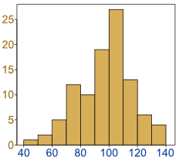
Basic visualisation - histograms
Frequency
Time to complete (seconds)
Notes:
Then what happens? We have a raft of issues to address
three's no clear cut law of emergence vs. convergence

Slide 11
Increasing the complexity – some science
Imagine that we have gathered together a large volume (100s of samples) of data on a given topic
Maybe we measured the height of people walking through the library at 2 different times of day
Maybe we measured the speed at which people with green t-shirts sorted some cards compared to people in red
Assume there is a difference in the averages of our 2 sets of samples. How can we be sure that this difference is not the result of random chance in our sampling?
Notes:
Then what happens? We have a raft of issues to address
three's no clear cut law of emergence vs. convergence

Slide 12
Understand the problem: Sample vs. population
Population – all the people you want to observe and know about
Sample – a group of people drawn from the population for the purposes of your experiment because you can’t work with everyone.. usually
Assume there is a difference in the averages of our 2 sets of samples. How can we be sure that this difference is not the result of random chance in our sampling?
Notes:
Then what happens? We have a raft of issues to address
three's no clear cut law of emergence vs. convergence

Slide 13
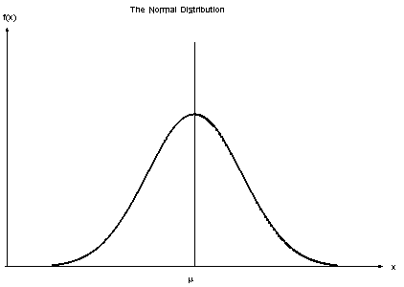
Make an assumption – populations have a normal distribution
Frequency
(count)
Measure (units)
Notes:
Then what happens? We have a raft of issues to address
three's no clear cut law of emergence vs. convergence

Slide 14
Null hypothesis – there is no difference
Frequency
(count)
Measure (units)
Notes:
Then what happens? We have a raft of issues to address
three's no clear cut law of emergence vs. convergence

Slide 15
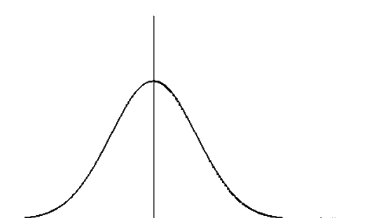
H1– there is a real difference
Frequency
(count)
Measure (units)
Notes:
Then what happens? We have a raft of issues to address
three's no clear cut law of emergence vs. convergence

Slide 16
So… can we prove that there is a difference in populations from the stats tests that we use?

Slide 17
Statistical Significance
Statistical Significance Tests describes how likely it is that the difference observed between two samples is because of natural variation within a single population they are drawn from
Tests are influenced by
means of the groups
their standard deviation
the size of the sample (often in HCI this equates to the number of participants and the number of conditions they are shown)

Slide 18
Statistical Significance
Example 1:
With two close averages (3.2, 3.1) and large std. dev.(2.0, 1.8) probability that two samples are from the same population is high
Example 2:
When averages are far apart (2.6, 4.2) and std. dev. Low (1.3, 1.1) then the likelihood that they are from the same population is low!

Slide 19
Statistical Significance
We usually seek to have statistical significance at the 5% probability level
If there is a difference found in an experiment, we’re 95% certain it is not observed because of variation in sampling the population)
Higher results are seldom acceptable
But this number is arbitrary!
For provisional studies, descriptive statistics alone may be sufficient

Slide 20


The t-test
It assumes that the results being analysed are
Normally distributed (bell-curve) (mean = mode = median)
The Dependent Variable (the thing you are measuring in response to what you change) is Continuous
Results are split across two conditions
Notes:
We don’t know is the short answer to point one
Not just career but life!
Dr.s and Lawyers
Argument about professional obligations
This is going on around you as we speak!
ITS ALSO ABOUT SKILLS DEVELOMMENT – RESEARCH AND CRITICAL APPRAISAL
TRANSITION: What’s going on in this lecture?

Slide 21
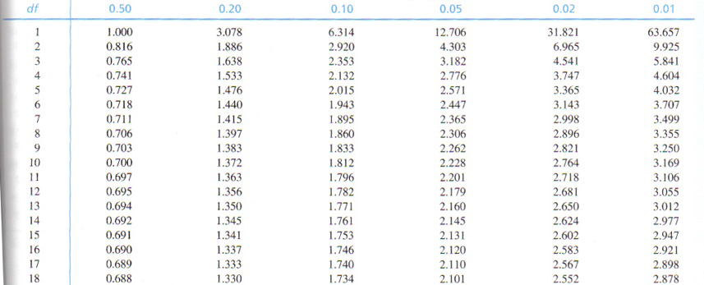
t-test Table
You look up by (total number of results – number of groups), and it will tell you a minimum ‘t-value’ for significance
e.g. 6 results - 2 groups -> 4 degrees of freedom
Notes:
We don’t know is the short answer to point one
Not just career but life!
Dr.s and Lawyers
Argument about professional obligations
This is going on around you as we speak!
ITS ALSO ABOUT SKILLS DEVELOMMENT – RESEARCH AND CRITICAL APPRAISAL
TRANSITION: What’s going on in this lecture?

Slide 22
Major categories of t-test
Equal sample sizes, equal variance
Unequal sample sizes, equal variance
Unequal (or equal) sample sizes, unequal variances
Unpaired (we just did) – where the user has done both experimental conditions
“Paired” – when comparing two samples of the same thing (e.g. 10 users, each using system A and B)
This can be thought of as the test to use when someone undergoes a treatment
Notes:
We don’t know is the short answer to point one
Not just career but life!
Dr.s and Lawyers
Argument about professional obligations
This is going on around you as we speak!
ITS ALSO ABOUT SKILLS DEVELOMMENT – RESEARCH AND CRITICAL APPRAISAL
TRANSITION: What’s going on in this lecture?

Slide 23
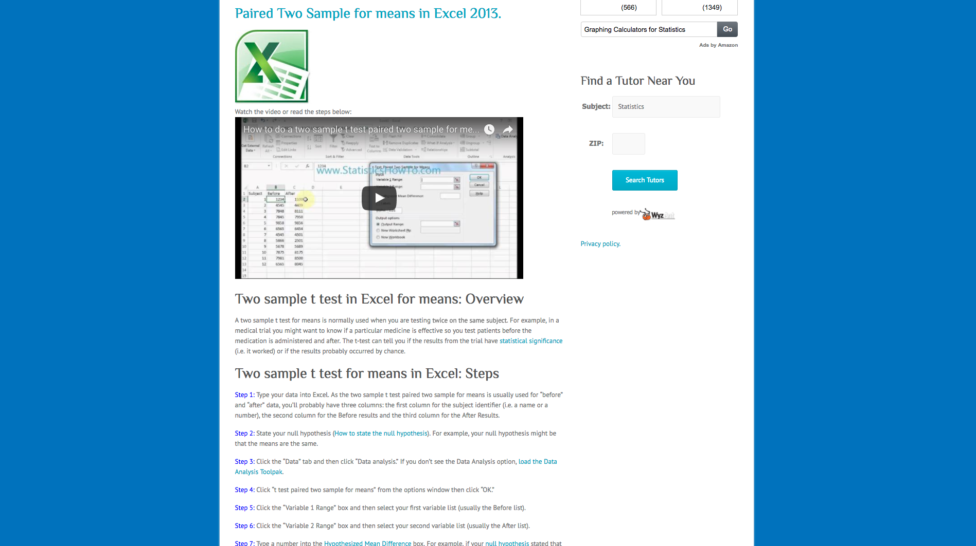

Slide 24
Independent \ Dependent | Continuous (e.g. time) | Ranked (e.g. Likert scale) | Frequencies (e.g. pass/fail)
2-condition (e.g. 2 UI’s) | t-test | Wilcoxon | chi-squared
Discrete (e.g. 3 difficulties) | ANOVA | Rank-Sums
Continuous (e.g. height) | Regression Analysis | Spearman's rank | Group then do chi-squared
Notes:
Why have we not used “Discrete” in top row?
Power of a test, low power good/ bad
Low power in hci!
Dimensions when selecting a test
You can do a degree in stats!

Slide 25
Power in Statistics Tests
Independent\ Dependent | Continuous (e.g. time) | Ranked (e.g. Likert scale) | Frequencies (e.g. pass/fail)
2-conditions (e.g. 2 UI’s) | t-test | Wilcoxon | chi-squared
Discrete (e.g. 3 difficulties) | ANOVA | Rank-Sums
Continuous (e.g. height) | Regression Analysis | Spearman's rank | Group then do chi-squared
Notes:
Why have we not used “Discrete” in top row?
Power of a test, low power good/ bad
Low power in hci!
Dimensions when selecting a test
You can do a degree in stats!

Slide 26
Power and Selecting the Right Rest
2 Conditions – No numerical relationship between the conditions
Discrete – does a relationship hold across these?
Continuous – how strong is the relationship between these two numbers
Depending on the type of data you gather, you use different statistical tests
The result of a test is invalid if you use a test that is too powerful
You can get away with a smaller number of samples if you use a more powerful test
Taken together this means you should design tests to be as powerful as possible
Notes:
We don’t know is the short answer to point one
Not just career but life!
Dr.s and Lawyers
Argument about professional obligations
This is going on around you as we speak!
ITS ALSO ABOUT SKILLS DEVELOMMENT – RESEARCH AND CRITICAL APPRAISAL
TRANSITION: What’s going on in this lecture?

Slide 27
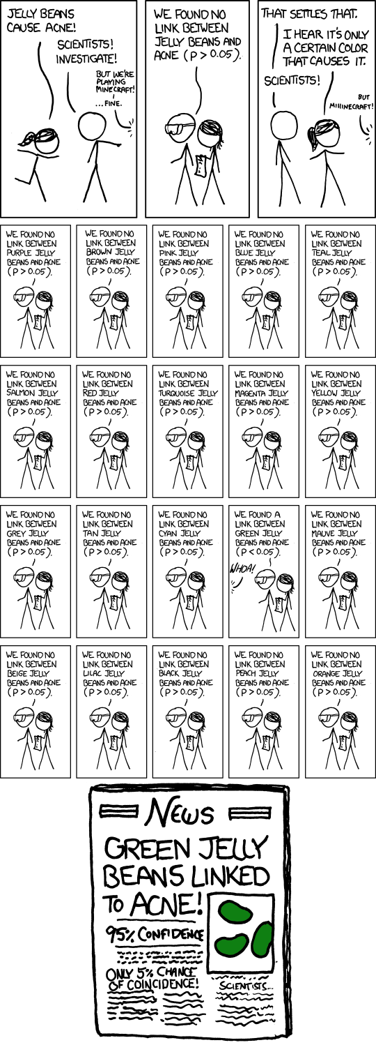

Slide 28
Final note of caution: Data Dredging
You must define your hypothesis prior to running your study
If you wish to analyse a large volume of data looking to find links in it you need to adjust for this
If you have many hypothesis the simple correction is to divide the p value by the number of hypothesis (Bonferroni correction)
There are more elegant solutions though
If you simply want to examine data there re other ways of doing it – post-hoc analysis
Main differences are in the reporting and interpretation of the analysis
Notes:
We don’t know is the short answer to point one
Not just career but life!
Dr.s and Lawyers
Argument about professional obligations
This is going on around you as we speak!
ITS ALSO ABOUT SKILLS DEVELOMMENT – RESEARCH AND CRITICAL APPRAISAL
TRANSITION: What’s going on in this lecture?

Slide 29
Lecture Summary
Statistics are one of the fundamental ways that we gather evidence about our work
Descriptive statistics can be used to summarise a large volume of data or describe it without looking at it
We can also visualise the data using techniques like histograms
Sample vs. population problem lies at the heart of more complex stats
We need to understand that significance tests tell us the probability of the random sampling giving rise to an observed difference given the null hypothesis
Notes:
Then what happens? We have a raft of issues to address
three's no clear cut law of emergence vs. convergence

Slide 30
CSC349 User Experience
Statistical Tests of Significance: t-tests, chi-squared, ANOVA and others
Notes:
Welcome to CS-130
Should be fun!
The “just don’t get caught module”
Teach how to program, teach you how to design stuff, teach you how to work in teams, what’s the point of this module?

Slide 31
Lecture Overview
In this lecture we will try to understand some more simple stats terms that will enable us to understand the fundamental elements of more complex tests
We will look at how to choose between several different tests without loosing any statistical power unnecessarily
We will talk specifically about Chi-squared tests, t-tests and ANOVA
Notes:
We don’t know is the short answer to point one
Not just career but life!
Dr.s and Lawyers
Argument about professional obligations
This is going on around you as we speak!
ITS ALSO ABOUT SKILLS DEVELOMMENT – RESEARCH AND CRITICAL APPRAISAL
TRANSITION: What’s going on in this lecture?

Slide 32
Statistical power and selection
Certain stats tests are only applicable to certain types of data
For example, you can’t do a t-test on data unless they are continuous
Tests that can work on ranked or even frequency data are typically less powerful
This means that they are less likely to find a statistically significant difference even when there really is one
As such, we always want to choose the most powerful test we can
Notes:
We don’t know is the short answer to point one
Not just career but life!
Dr.s and Lawyers
Argument about professional obligations
This is going on around you as we speak!
ITS ALSO ABOUT SKILLS DEVELOMMENT – RESEARCH AND CRITICAL APPRAISAL
TRANSITION: What’s going on in this lecture?

Slide 33
Independent/ Dependent | Continuous (e.g. time) | Ranked (e.g. Likert scale) | Frequencies (e.g. pass/fail)
2-valued (e.g. 2 UI’s) | t-test | Wilcoxon | chi-squared
Discrete (e.g. 3 difficulties) | ANOVA | Rank-Sums
Continuous (e.g. height) | Regression Analysis | Spearman's rank | Group then do chi-squared
Notes:
Why have we not used “Discrete” in top row?
Power of a test, low power good/ bad
Low power in hci!
Dimensions when selecting a test
You can do a degree in stats!

Slide 34
Independent/ Dependent | Continuous (e.g. time) | Ranked (e.g. Likert scale) | Frequencies (e.g. pass/fail)
2-valued (e.g. 2 UI’s) | t-test | Wilcoxon | chi-squared
Discrete (e.g. 3 difficulties) | ANOVA | Rank-Sums
Continuous (e.g. height) | Regression Analysis | Spearman's rank | Group then do chi-squared
Notes:
Why have we not used “Discrete” in top row?
Power of a test, low power good/ bad
Low power in hci!
Dimensions when selecting a test
You can do a degree in stats!

Slide 35
Statistical power and selection
Every statistical test has conventions about how it is reported that allow you to check they were done correctly
When reporting a t-test:
t(df) = score, p<p-score
t(4)=4.8990, p<0.008
More on reporting:
http://my.ilstu.edu/~jhkahn/apastats.html
Notes:
We don’t know is the short answer to point one
Not just career but life!
Dr.s and Lawyers
Argument about professional obligations
This is going on around you as we speak!
ITS ALSO ABOUT SKILLS DEVELOMMENT – RESEARCH AND CRITICAL APPRAISAL
TRANSITION: What’s going on in this lecture?

Slide 36
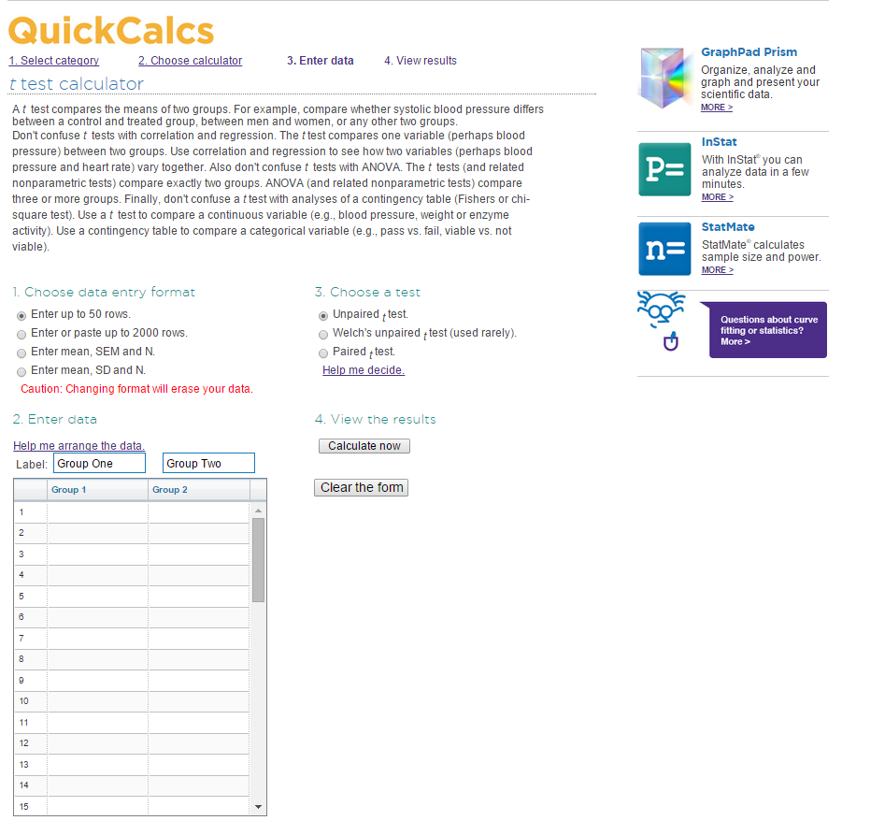

Slide 37
Independent/ Dependent | Continuous (e.g. time) | Ranked (e.g. Likert scale) | Frequencies (e.g. pass/fail)
2-valued (e.g. 2 UI’s) | t-test | Wilcoxon | chi-squared
Discrete (e.g. 3 difficulties) | ANOVA | Rank-Sums
Continuous (e.g. height) | Regression Analysis | Spearman's rank | Group then do chi-squared
Notes:
Why have we not used “Discrete” in top row?
Power of a test, low power good/ bad
Low power in hci!
Dimensions when selecting a test
You can do a degree in stats!

Slide 38
ANOVA
ANalysis Of VAriance
Like a t-test is for a simple and a hard user interfaces, an ANOVA is for 3+ user interfaces
But only tells you if the OVERALL TREND is significant
A post-hoc Tukey test tells you which DVs are significantly more impactful than any others in that trend
Reporting: F(df1,df2)=f-score, p<p-score
e.g. F(1,145)=5.43, p<0.05
Notes:
We don’t know is the short answer to point one
Not just career but life!
Dr.s and Lawyers
Argument about professional obligations
This is going on around you as we speak!
ITS ALSO ABOUT SKILLS DEVELOMMENT – RESEARCH AND CRITICAL APPRAISAL
TRANSITION: What’s going on in this lecture?

Slide 39
ANOVA
One-way ANOVA - determine whether there are any significant differences between the means of three or more independent (unrelated) groups
If it’s just 2 then we use a t-test
Assumes that there is 1 Independent Variable
Multiple ANOVA - when you want to check on 6 UIs (Ivs) differing in 2 DVs(e.g. font size (big or small) and background colour (white/ blue/grey)) vs speed and accuracy
Gets complicated fast, very reliant on having a well distributed sample
Notes:
We don’t know is the short answer to point one
Not just career but life!
Dr.s and Lawyers
Argument about professional obligations
This is going on around you as we speak!
ITS ALSO ABOUT SKILLS DEVELOMMENT – RESEARCH AND CRITICAL APPRAISAL
TRANSITION: What’s going on in this lecture?

Slide 40
Independent/ Dependent | Continuous (e.g. time) | Ranked (e.g. Likert scale) | Frequencies (e.g. pass/fail)
2-valued (e.g. 2 UI’s) | t-test | Wilcoxon | Chi-squared
Discrete (e.g. 3 difficulties) | ANOVA | Rank-Sums
Continuous (e.g. height) | Regression Analysis | Spearman's rank | Group then do chi-squared
Notes:
Why have we not used “Discrete” in top row?
Power of a test, low power good/ bad
Low power in hci!
Dimensions when selecting a test
You can do a degree in stats!

Slide 41
Chi-Squared
“Pearson’s Chi-squared test of goodness of fit” to give it the full name
Assume it is this if the full name is not specified
Calculate the expected value for each cell
expected value = (row total x col total) / n
 | Pass | Fail | Total
Boys | 35 (39.3) | 50 (45.6) | 85
Girls | 41 (36.6) | 38 (42.4) | 79
Total | 76 | 38 | 164
Notes:
We don’t know is the short answer to point one
Not just career but life!
Dr.s and Lawyers
Argument about professional obligations
This is going on around you as we speak!
ITS ALSO ABOUT SKILLS DEVELOMMENT – RESEARCH AND CRITICAL APPRAISAL
TRANSITION: What’s going on in this lecture?

Slide 42
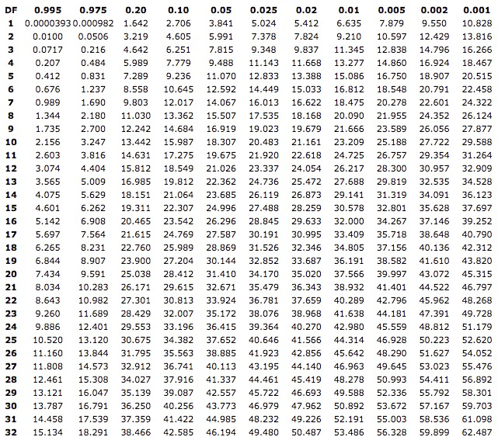
Chi-Squared
chi-squared = SUM OF: (observed - expected) ^ 2
expected
=1.89 in this example
DF = (#rows-1) x (#cols-1) = 1
then see if X2 > score in table
not very significant this time
Notes:
We don’t know is the short answer to point one
Not just career but life!
Dr.s and Lawyers
Argument about professional obligations
This is going on around you as we speak!
ITS ALSO ABOUT SKILLS DEVELOMMENT – RESEARCH AND CRITICAL APPRAISAL
TRANSITION: What’s going on in this lecture?

Slide 43
Final note of caution: Data Dredging
You must define your hypothesis prior to running your study
If you wish to analyse a large volume of data looking to find links in it you need to adjust for this
If you have many hypothesis the simple correction is to divide the p value by the number of hypothesis (Bonferroni correction)
There are more elegant solutions though
If you simply want to examine data there re other ways of doing it – post-hoc analysis
Main differences are in the reporting and interpretation of the analysis
Notes:
We don’t know is the short answer to point one
Not just career but life!
Dr.s and Lawyers
Argument about professional obligations
This is going on around you as we speak!
ITS ALSO ABOUT SKILLS DEVELOMMENT – RESEARCH AND CRITICAL APPRAISAL
TRANSITION: What’s going on in this lecture?

Slide 44
Summary
Choosing an appropriate stats test means understanding types of data you are collecting for Independent and Dependent variables
Sadly, I cannot teach you all of the details of testing
Statistics is a degree in of itself!
Once you have a rough idea you need to do research yourself
Fortunately, there are many, many great tools on the web and resources to help you with this
Notes:
We don’t know is the short answer to point one
Not just career but life!
Dr.s and Lawyers
Argument about professional obligations
This is going on around you as we speak!
ITS ALSO ABOUT SKILLS DEVELOMMENT – RESEARCH AND CRITICAL APPRAISAL
TRANSITION: What’s going on in this lecture?

